Slide 1
Sustainable Building Materials: Insulation
Allandra Drobot

Slide 2
What did I do?
Chose 3 materials
Determined 2 factors to evaluate them with
Made 3 wall assemblies to compare data
Fiberglass
Cellulose
Hempcrete
Thermal Resistance
Embodied Carbon
Calculated the effective R-value
Calculated the embodied carbon
Compared the results

Slide 3
Why?
A substantial amount of material creates our built Environment.
Considering the sustainability of the materials we use could reduce our environmental impact at a large scale.
Insulation accounts for a large portion of a building's energy efficiency and comfort. And it is a relevant topic with the current improvements in the building industry.

Slide 4
The Insulations
01. Fiberglass batts – molten glass that is spun or blown into fine glass fibers. Can contain recycled glass
02. Cellulose fiber – primarily recycled paper fiber
03. Hempcrete – hemp bio-fiber and a mineral binder, usually lime based.

Slide 5
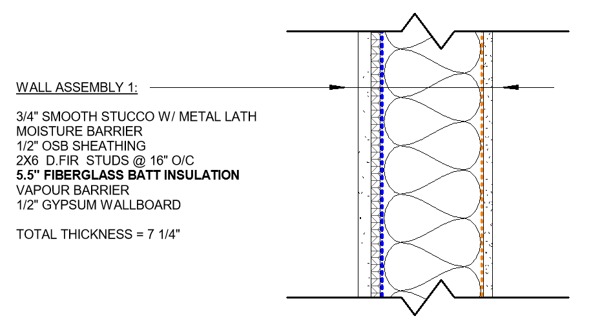
The Wall Assemblies
Fiberglass Batt infill:
Typical 2x6 assembly.
R18.07 3.35 kg of CO2 per 16” of assembled wall

Slide 6
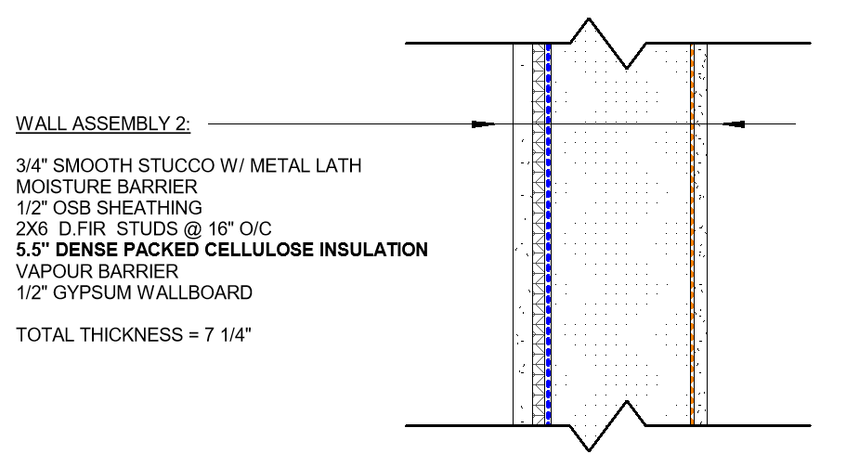
The Wall Assemblies
Dense packed cellulose infill:
Typical 2x6 assembly.
R19.32 2.12 kg of CO2 per 16” of assembled wall
*Higher R-value compared to fiberglass
*More common to use for insulating attics due to the process of installing it

Slide 7
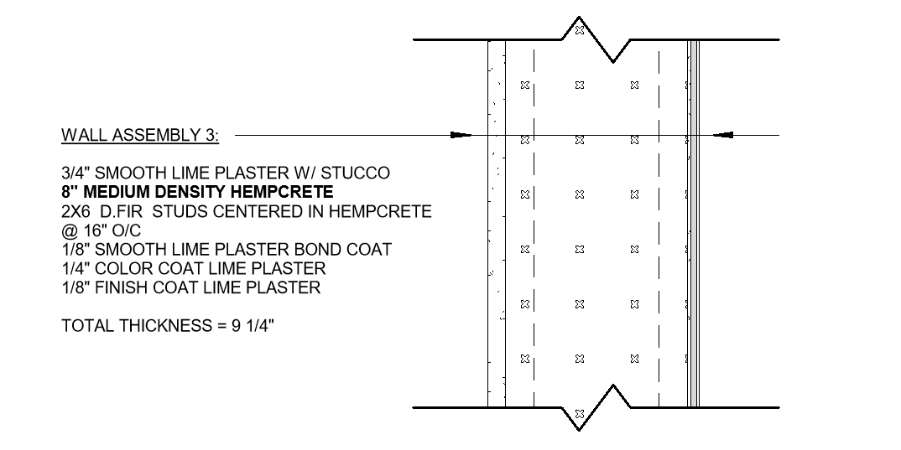
The Wall Assemblies
Hempcrete wall assembly:
Single stud 2x6 framing centered in hempcrete.
R18.05 -149.06 kg of CO2 per 16” of assembled wall
*Comparable R-value compared to fiberglass *No thermal bridging *Had the advantage of 8” thickness *Carbon sequestration during the cultivating process of hemp *Can be finished with just plaster

Slide 8
PHOTOS OF HEMPCRETE CONSTRUCTION

Slide 9
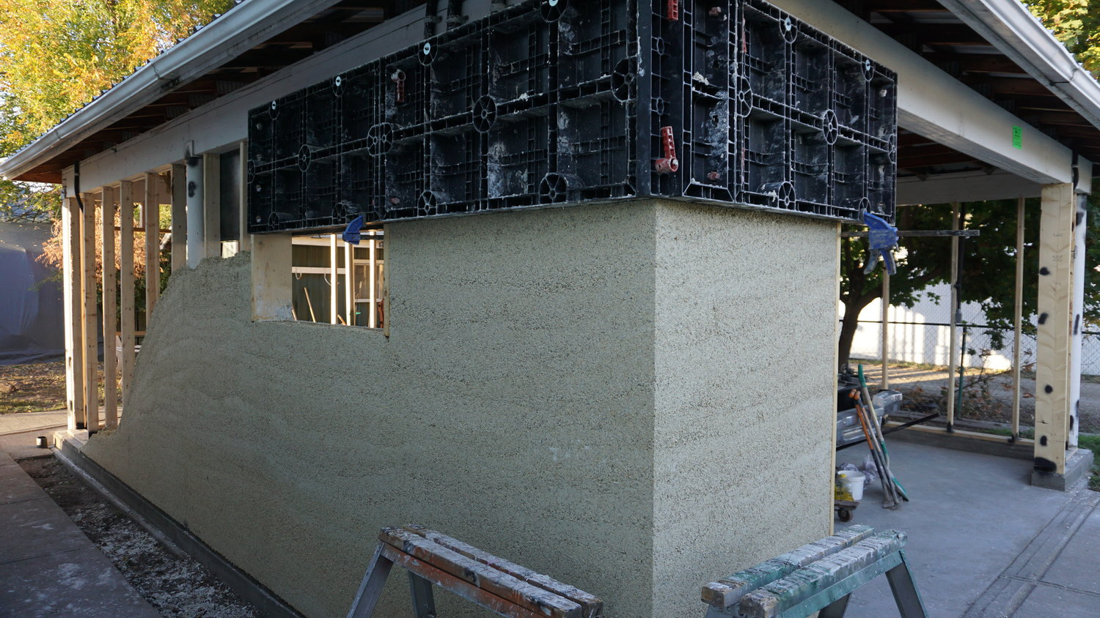
Portrait of a team member

Slide 10
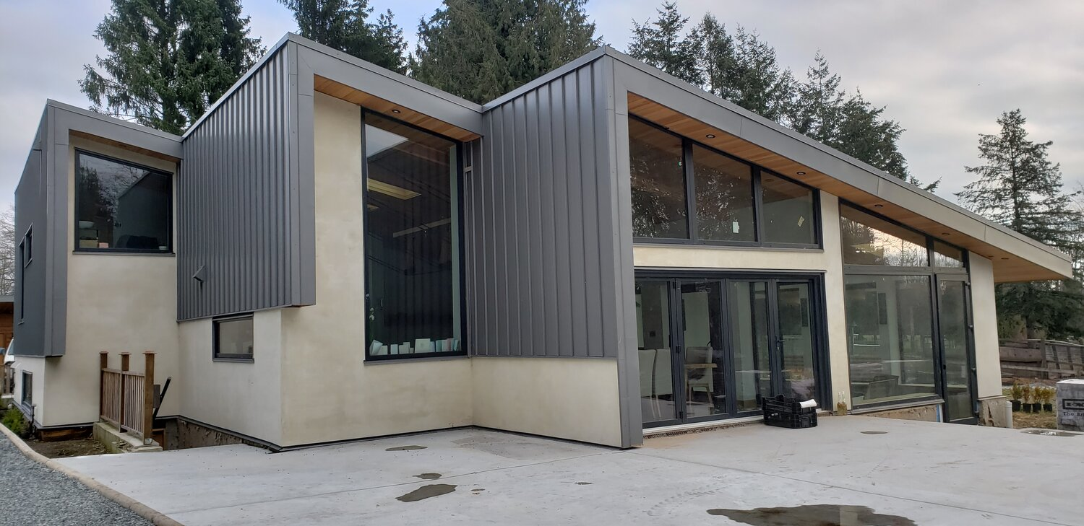

Slide 11
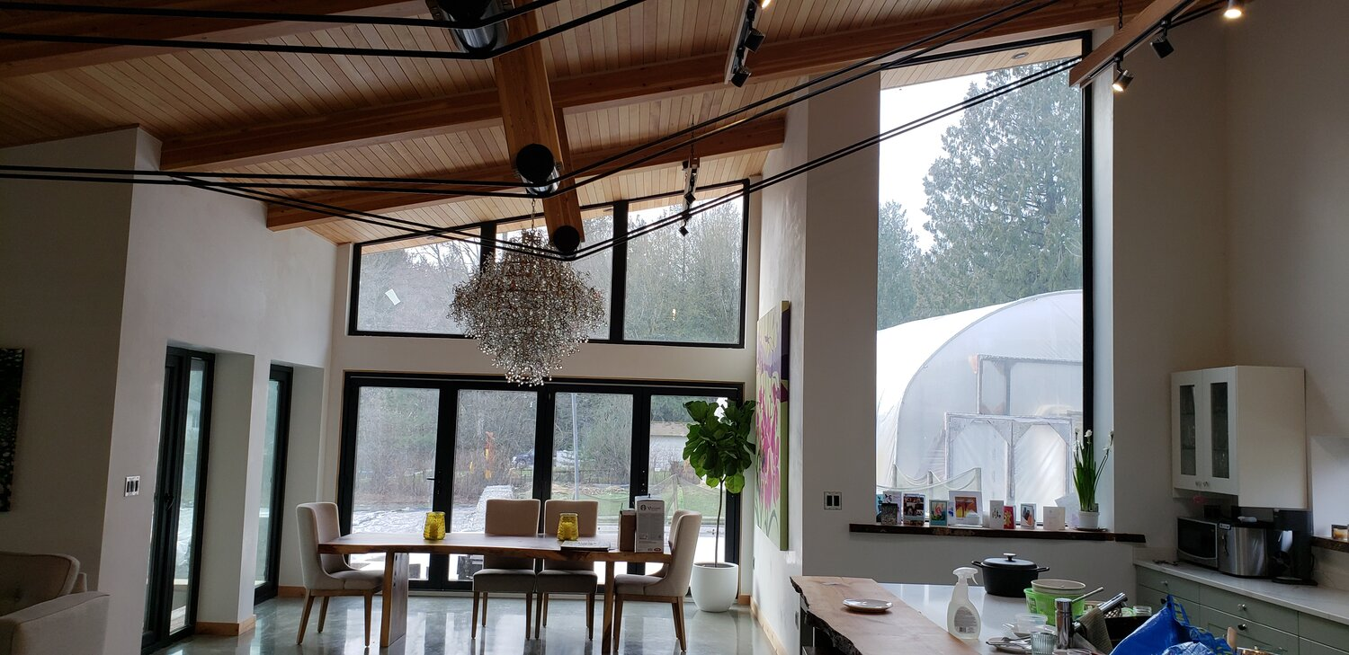

Slide 12
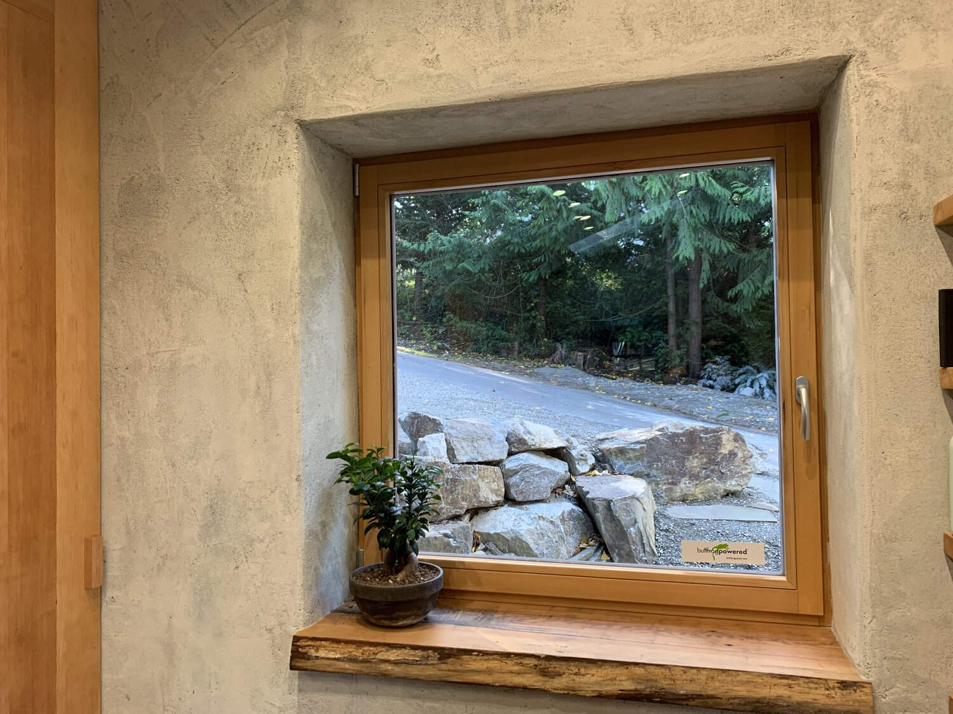

Slide 13
Thank you

